Slide 1
EE 295
TechWriting-Engineering Ethics
Oct 29, 2018
Room E339
Tom Wrappe
EE Lecturer

Slide 2
-Resume Research
-Resume Research Practice Examples
+Skills
+Experience
+Uniqueness
-Final Paper
-Sources
-Outline/Abstract
-Materials Ethics
+ More Product Analysis

Slide 3
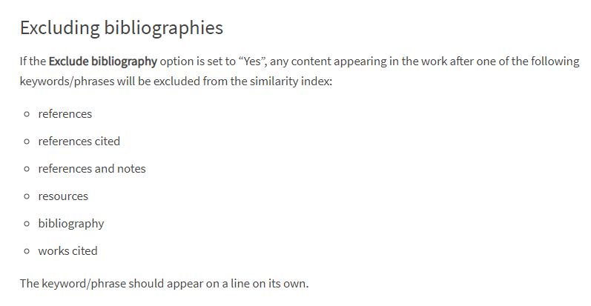
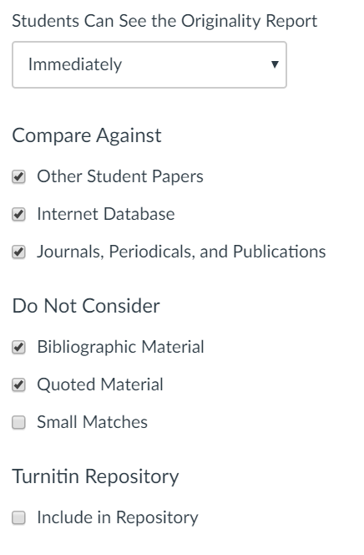
Getting to 15%: Source
Settings
For excluding bibliographies
https://elearning.qmul.ac.uk/guide/excluding-references-and-quotations-from-turnitin-reports/#references

Slide 4
Fair Warning
In Class Writing Exercise starting at beginning or end of class coming within next two weeks (be on time)
Allowed 25 minutes to complete (hard stop)
Topic will be per recent class lectures and discussions
Up to 10 points with 0 for “no show”
No makeups per syllabus
Attend your own section unless cleared at least 24 hour ahead in writing (deduction otherwise)

Slide 5
Semester Major Items…..(subject to modification)
 | Mid Term | Resume | Final Paper | Final Presentation (slides )
Topic Paragraph | 9.5.19
Topic Proposed | 9.12.19 |  | 10.3.19
Topic Final | 9.19.19 |  | 10.10.19
Outline/ Abstract | 9.26.19 |  | 10.31.19
Research | 10.1.19 | 10.24.19 (Class) | 10.15.19
Draft Complete | 10.13.19 ** |  | 11.10.19** | 11.19.19
Final Submit | 10.25.19 ** | 11.14.19 | 11.26.19 | 12.3.19
Final Presentation | NA | NA | NA | 12.17.19 (Sect 1) 12.12.19 (Sect 2)

Slide 6
Resume Analysis

Slide 7
Start the Resume Research
-Posted on Canvas
-Final Due Nov 14, 2019
-BRING AT LEAST ONE JOB POSTING TO CLASS TU, Oct 29 and/or TH, Oct 31
-Find three (3) job postings. Analyze them, and determine what will influence the company to select you for consideration.
Write an analysis paragraph for each indicating how you think they will make the decision, what you have to offer, what you hope to get, and what the company will offer, and what they hope to get.
Indicate what you will place in the resume to influence the decision maker. Look beyond just the technical.
Write a targeted resume for each company.
Submit analysis and resumes on Canvas. The analysis must be plagiarism checked. Please put analysis and resumes in separate files. The resumes will be checked, but not scored.

Slide 8
Resume OOC Exercise
Analyze the job description and determine what will influence the company to select you for consideration
Write an analysis of each job indicating how you think the company will make the decision to interview and hire
what you have to offer, and what you hope to get
what the company will offer, and what they hope to get.
Indicate what you will place in the resume to influence the decision maker.
Look beyond just the technical

Slide 9
The OOC Work Product
Provide a summary of the analysis you are going to perform and the elements that you are going to provide for each of the three job descriptions
Answer all the questions that are laid out in the assignment in a consistent, readable way
Finish up with a short conclusion on each analysis
Attach the resumes as a followon to the analysis
High Level Outline for OOC Assignment
Summary of assignment and your approach to analysis
Analysis #1
Analysis #2
Analysis #3
Resume #1, 2, 3

Slide 10
Resume Analysis
 | Company Analysis |  |  | Self Analysis
Job Descript | How you think the company will make the decision | What the company will offer | What company hopes to get | What you have to offer | What you will place in resume to influence (“wild card”)
#1:
#2:
#3:

Slide 11
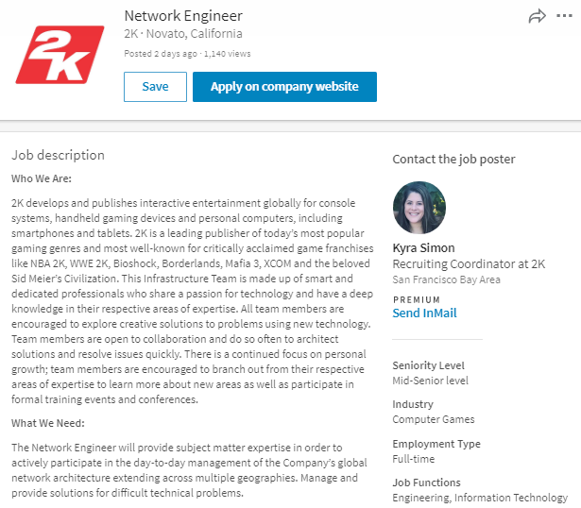

Slide 12
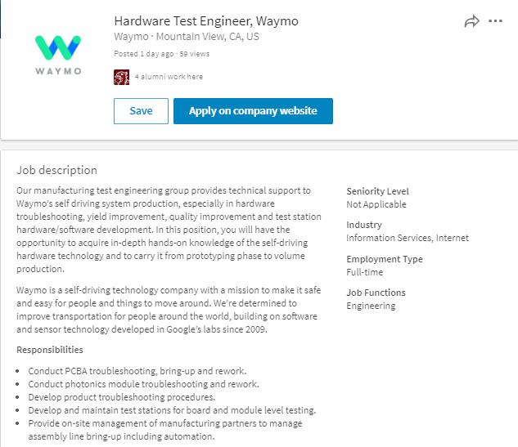

Slide 13
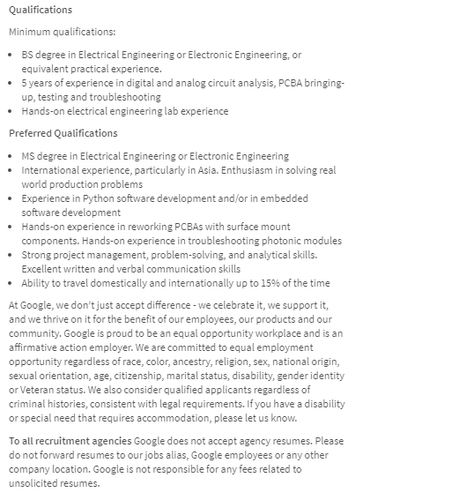

Slide 14
Final Paper Options

Slide 15
Expanding the Product Proposal for a Final Paper
Outline | Outline/ Abstract | Draft (5 pages) | Midterm paper (5 pages) | Final Paper ? 15 pages
1. Abstract | Paragraph | ½ page max | ½ page max | 1. Abstract
2. Executive Summary | paragraph | ½ to 1 page | ½ to 1 page | 2.Executive Summary
3. Product Description | 2 paragraphs or so | 1-3 pages |  | 3.0 Product Description (ex.) 3.1 System Description (ex) 3.2 Key technologies 3.3 Functional Description (ex.)
4 Mkt Research and Analysis | 1-2 paragraphs (5 sources min) | 1-3 pages | Depends on sources | 4.0 Mkt Rsch 4.1 Market 4.2 Competitors 4.3 Differentiators
5. Finance and Economics | Short paragraph | ½ to 1 page
6. Management Team | Short paragraph | ½ page
7. Risks and Assumptions | Short paragraph | ½ page
8. Conclusions and Recommendations | Short paragraph | ¼ to ½ page |  | 8. Concl/ Rec’s 8.1 Useful features 8.2 Recommended action
A. Sources | Not Applicable | ½ to 1 page | ½ to 1 page

Slide 16
Framework for Research Option #2
Area of Research
The “container” is the Analysis Process you choose:
-Compare multiple technologies by measuring their performance in a consistent “test” process (Comparative Analysis)
-Measure a single technology’s ability to perform a previously unachievable “test” (Feasibility Study)
Specific Topic
(Describe Specific Research
Research is a fluid.
It has the form of the container you choose.
Criteria for Analysis
ANALYSIS
Results and Implications
Conclusions &Recommendations

Slide 17
Final Paper: Outline/Abstract due Oct 31
Submit an outline and an abstract For your final Paper using 1-2 pages
Expand on your topic selection
-”Fine tune” your topic
-Create outline based on the complete Product Proposal or Research Paper outline
-Prepare a summary with one or two paragraphs (not bullet items, full sentence-based paragraphs) that capture the key elements of each section
Summarize your market and technology research (previously 20 sources)
-Fill out a complete checklist per instructions as a condition of grading
3.Provide a “budget” totaling 7200 +/- words (15 pages) for your Final Paper (Extended Proposal) or 5600-6000 words (10 pager Research)
4.Be ready to discuss during Nov 5 and/or Nov 7 class
5. Checklist and Peer Review (2) within one week of deadline
6.As always, 15% plagiarism or less is required from Turnitin

Slide 18
Material Ethics
Material Ethics
Eugene Moriarity, (2008) “Material Ethics, Chapter 8” in The Engineering Project, Its Nature, Ethics and Promise, Penn State Press
Tom Wrappe
EE Lecturer

Slide 19
Material Ethics

Slide 20
Conclusions
Focal Product
Major difference between “modern engineering” and “focal engineering”
Modern engineering will endure and supply useful, helpful products that do not positively address the “well being” of users
Focal engineering strives for more than just usefulness, and seeks to identify focal products that enliven and energize the user

Slide 21
In Class Discussion to Be Continued This Week
Focal Products
Research Examples of Focal Products
Candidates will be discussed in class and put forth in class discussion

Slide 22

MATERIAL ETHICS/ Focalness of Product
PRODUCT
RESONANCE
ENGAGEMENT
ENLIVENMENT
END-USER
WORLD

Slide 23
10 Technologies That Deserve to Die?
1. Nuclear Weapons
2. Coal- Based Power
3. The Internal Combustion Engine
4. Incandescent Light Bulbs
5. Land Mines
6. Manned Spacecraft
7. Prisons
8. Cosmetic Implants
9. Lie Detectors
10. DVDs
Define the Technologies
Ethically, do They Deserve to Die? How would you score the Materials Ethics of the identified technology?

Slide 24
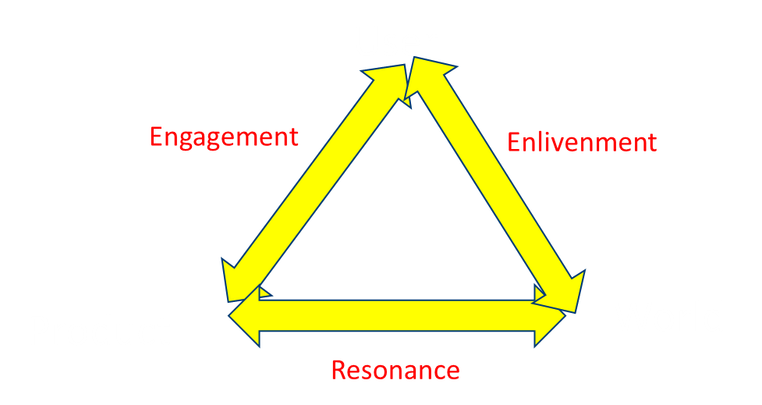
Assessing Focal Product
Engagement: End User and Product interaction→ (+3 to -3)
Enlivenment: End User and World (based on use of product)→ (+3 to -3)
Resonance: Product and World Interaction→ (+3 to -3)
Jm= a1(Jeg) +a2(Jen) +a3(Jre), where a1+a2+a3=1.0

Slide 25
10 Emerging Technologies
1. Comparative Interactomics:
2. Nanomedicine
3. Epigenetics
4. Cognitive Radio
5. Nuclear Reprogramming
6. Diffusion Tensor Imaging
7. Universal Authentication
8. Nanobiomechanics
9. Pervasive Wireless
10. Stretchable Silicon
What is the Technology?
Do you foresee any moral dilemma's with this technology?
Can it be focal or contribute to a focal product?

Slide 26
The 2017 List MIT Enterprise Forum
Reversing Paralysis - Scientists are making remarkable progress at using brain implants to restore the freedom of movement that spinal cord injuries take away.
Self-Driving Trucks -Tractor-trailers without a human at the wheel will soon
barrel onto highways near you. What will this mean for the nation’s 1.7 million truck drivers?
Paying with Your Face - Face-detecting systems in China now authorize payments, provide access to facilities, and track down criminals. Will other countries follow?
Practical Quantum Computers - Advances at Google, Intel, and several research groups indicate that computers with previously unimaginable power are finally within reach.
The 360-Degree Selfie - Inexpensive cameras that make spherical images are opening a new era in photography and changing the way people share stories.
Hot Solar Cells - By converting heat to focused beams of light, a new solar device could create cheap and continuous power.
Gene Therapy 2.0 - Scientists have solved fundamental problems that were holding back cures for rare hereditary disorders. Next we’ll see if the same approach can take on cancer, heart disease, and other common illnesses.
The Cell Atlas - Biology’s next mega-project will find out what we’re really made of.
Botnets of Things - The relentless push to add connectivity to home gadgets is creating dangerous side effects that figure to get even worse.
Reinforcement Learning - By experimenting, computers are figuring out how to do things that no programmer could teach them.

Slide 27
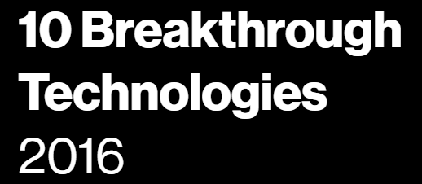
10 Emerging Technologies -MIT Review 2015
What is the Technology (4 Selected) and primary impact?
Do you foresee any moral dilemma's with this technology?
Can it be focal or contribute to a focal product?

Slide 28
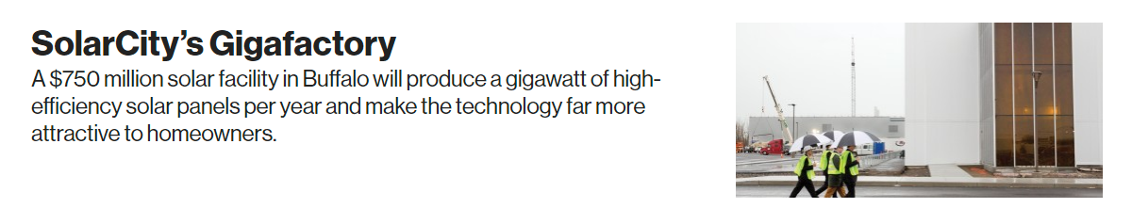
What is the Technology (4 Selected) and primary impact?
Do you foresee any moral dilemma's with this technology?
Can it be focal or contribute to a focal product?

Slide 29

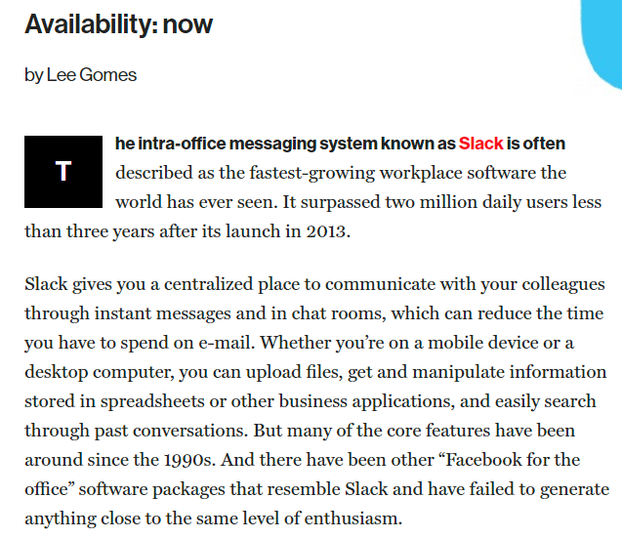
https://slack.com/about

Slide 30
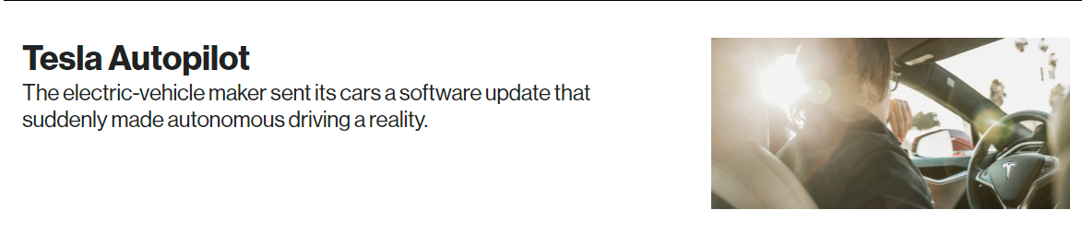

Slide 31
